Slide 1
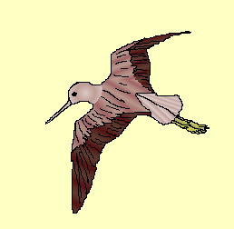
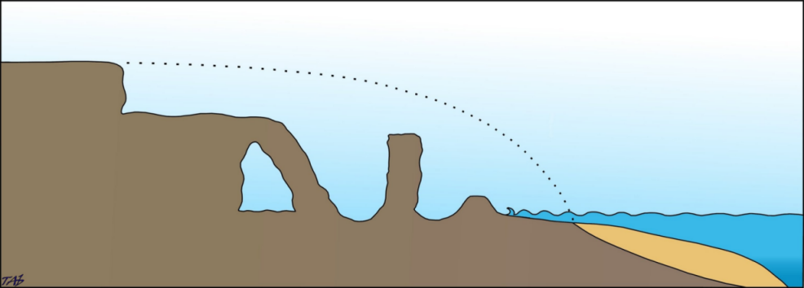
Old cliff
line
Original Land surface
stack
stump
Natural
Arch
Wave-cut platform

Slide 2
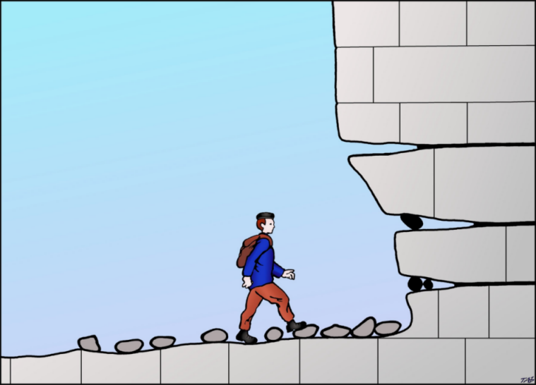
Cliff line
Joints and beds allow
waves to attack the cliff
more easily
HIGH TIDE LEVEL
Waves can use rocks to
erode the cliff
Wave cut platform
Wave cut
notch

Slide 3
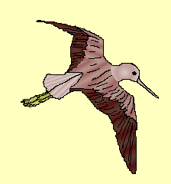
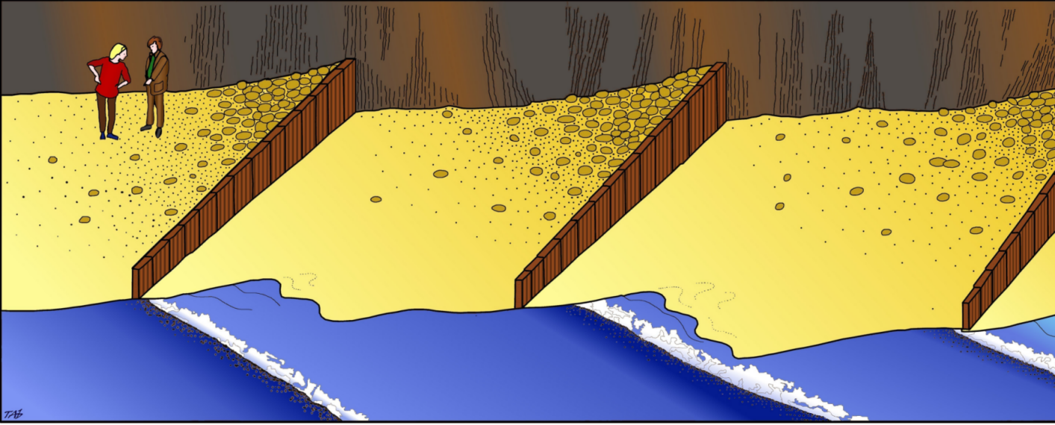
Sediment accumulation
due to Longshore Drift
Groynes
Waves approach beach
at oblique angle

Slide 4
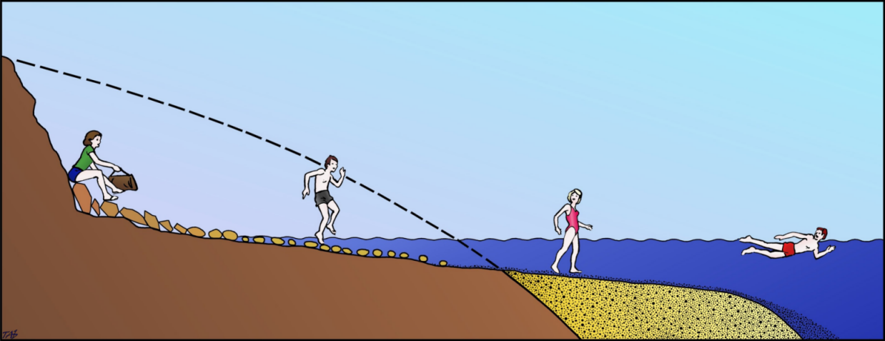
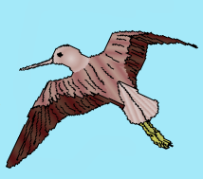
Wave-cut platform
Wave built terrace
Ouch!
large angular rocks
rocks and pebbles
soft sand

Slide 5
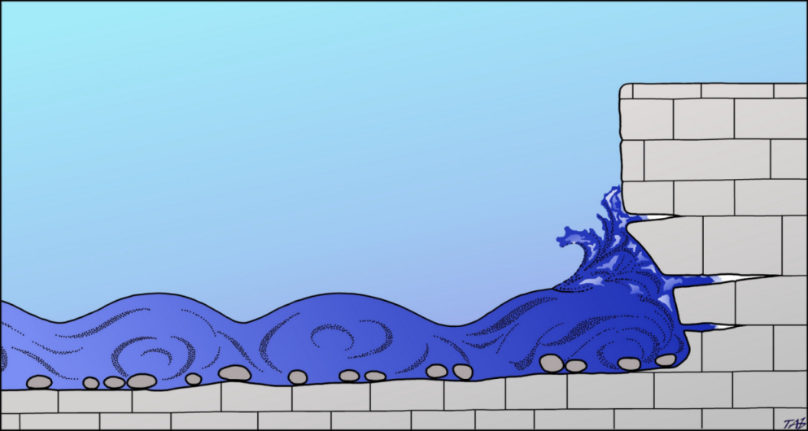
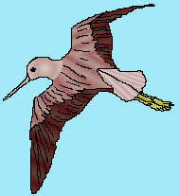
The force of the waves pushes air
into cracks in the rock
The compressed air exerts enormous pressure at the tip of the crack. As the water falls back the air pressure is released and rock is pulled out from the crack further enlarging the hole.

Slide 6
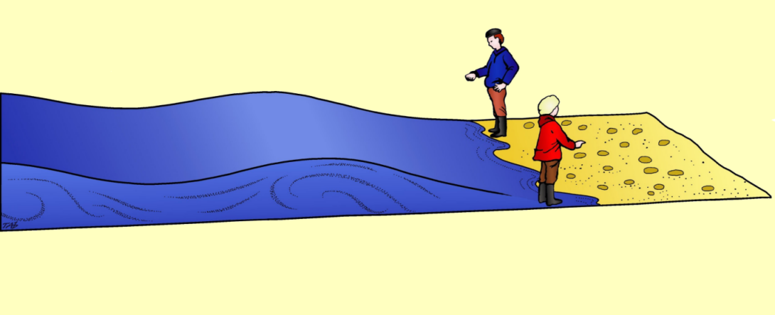
Constructive Waves
Spilling Breaker
Powerful Swash
Weak Backwash

Slide 7
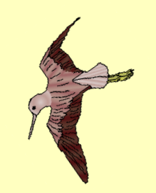
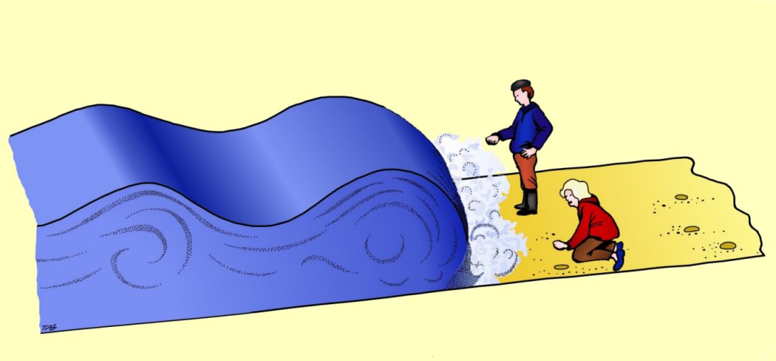
Constructive Waves
Crashing breaker
Weak swash
Powerful Backwash

Slide 8
This powerpoint was kindly donated to www.worldofteaching.com
http://www.worldofteaching.com is home to over a thousand powerpoints submitted by teachers. This is a completely free site and requires no registration. Please visit and I hope it will help in your teaching.

